Slide 1

Fair Share
Split Bills The Fair Way
Prof. Amuthan Arulraj
INFO 6150 Final Project

Slide 2
Project Description
FairShare is a user-friendly web app designed for effortless expense sharing among friends. With a sleek and intuitive interface, it simplifies the process of tracking and settling balances for various activities such as trips, dinners, and shared apartments. Users can easily add expenses like restaurant bills, rent, and utilities, splitting them equally or unevenly based on predefined shares.
Key features:
Expense Management: Easily upload expenses via the web or Excel, including features like photo receipts, categorization, and tagging friends.
Balances Overview: The Balances tab provides a comprehensive view of total owed/owing, breakdowns by friend and group, and historical balance charts.
Group Functionality: Create or join groups for tracking expenses related to trips, apartments, or events. Manage group members and view group-specific balances.
Notifications: Receive timely email notifications for payment reminders, group invites, balance updates, and added/removed expenses to ensure debts are settled promptly.
User Profiles: Securely sign up with email, create profiles with photos, bios, and contact details. Password reset functionality is available via email.
International Support: FairShare offers language support, catering to a diverse user base around the globe.
Dashboard: The main dashboard provides a quick overview of recent activities, balances owed, and recent expenses, enabling users to manage their finances efficiently.
Payments and Settlements: Track payments made between group members, record payments, and mark them as paid, ensuring accurate settlement records.
Export and Search: Export expenses to various formats (Excel, PDF) and utilize the search functionality for discovering spending, groups, and transactions with flexible filtering options.
FairShare Assurances: The app aims to reduce friction in expense sharing, providing users with a reliable platform to eliminate unpaid obligations and foster financial transparency among friends.

Slide 3
TEam Members
Dinesh Shekhawat
Tanmay Gokhale
NUID: 002776484
NUID: 002822060
Khushank Mistry
Dhruv Soni
NUID: 002209157
NUID: 002822421

Slide 4

Tech Stack
Frontend
React JS
Redux (for managing and centralizing application state)
Axios (for making api calls)
Material UI (for User Interface)
Backend
Express
Node
Mongoose
JWT (For authentication)
Multer, express-file-upload, cors, csv-parser, yamljs, swagger-ui-express, node-mailer
Database
MongoDB

Slide 5
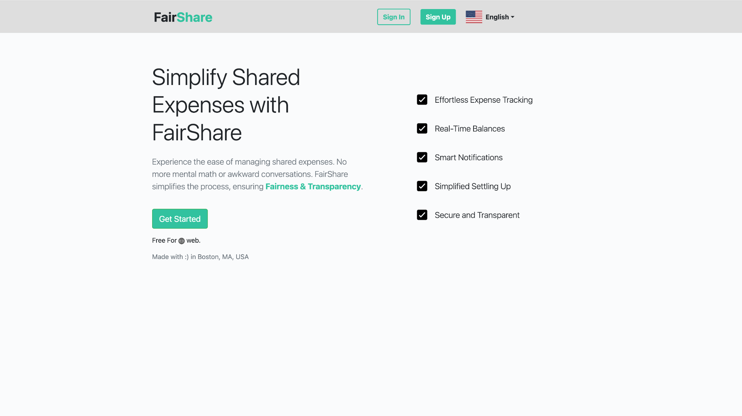
Home Page
Discover financial harmony with FairShare, your go-to platform for uncomplicated expense management.
Navigate shared expenses effortlessly with features like real-time balances, smart notifications, and simplified settling up, all crafted for a seamless experience. Our Boston-made platform guarantees fairness and transparency, providing a secure and transparent environment for worry-free shared finances.
Enjoy effortless expense tracking and say goodbye to awkward conversations and mental math. It's free for the web and made with love in Boston, MA, USA

Slide 6
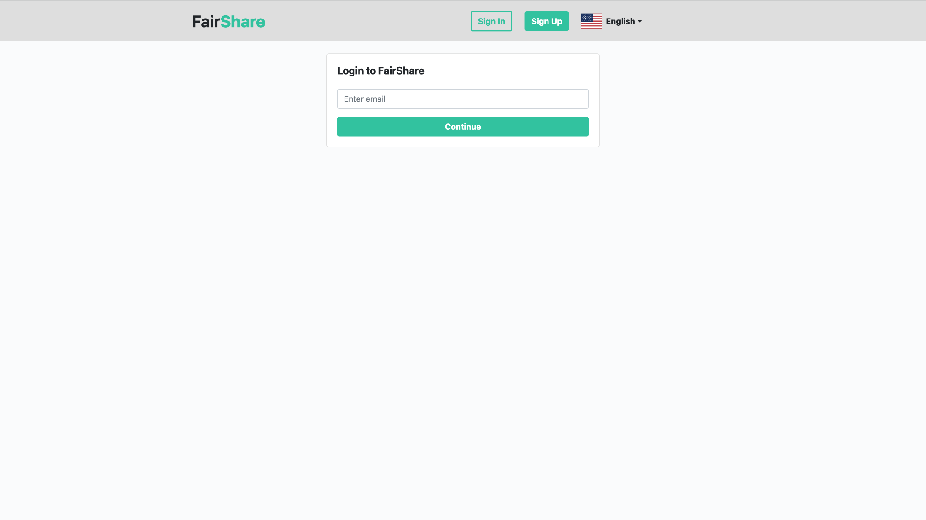
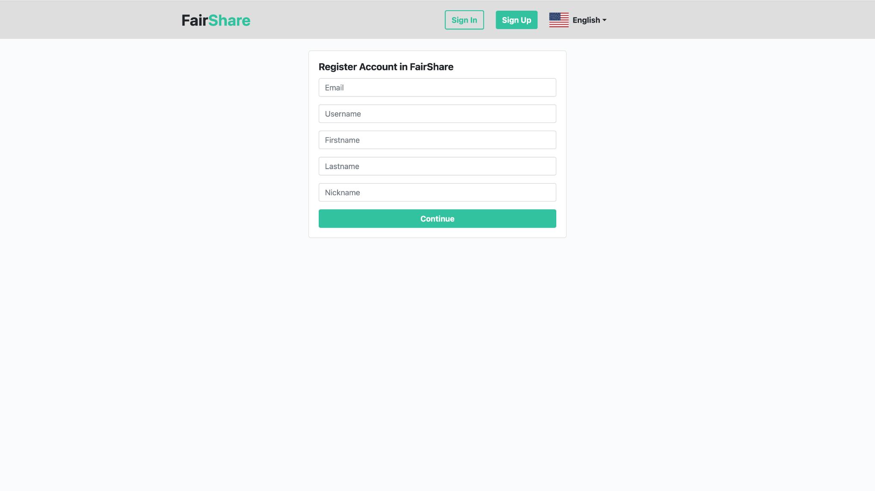
Login And Signup page
Embark on a seamless journey into our platform with our user-friendly React.js and Material UI-powered login and signup pages. Experience sleek, intuitive design that ensures a smooth onboarding process.
Effortlessly create an account or log in with just a few clicks, all while enjoying a visually appealing interface.
Our design prioritizes simplicity without compromising style, providing a delightful entry point to your personalized experience. Welcome to a world of hassle-free authentication and vibrant design!

Slide 7
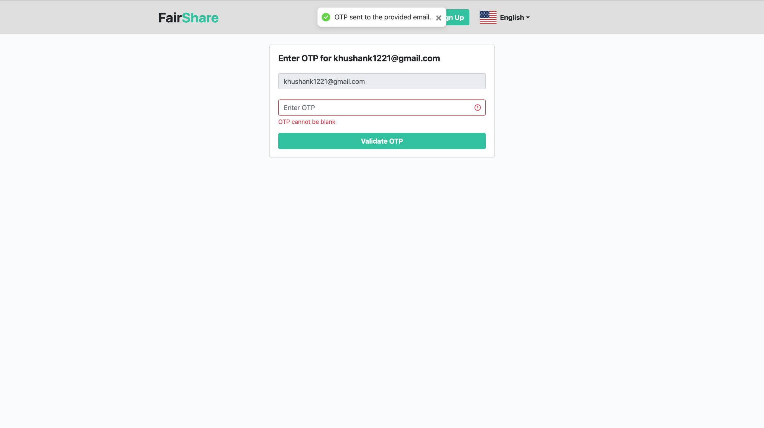
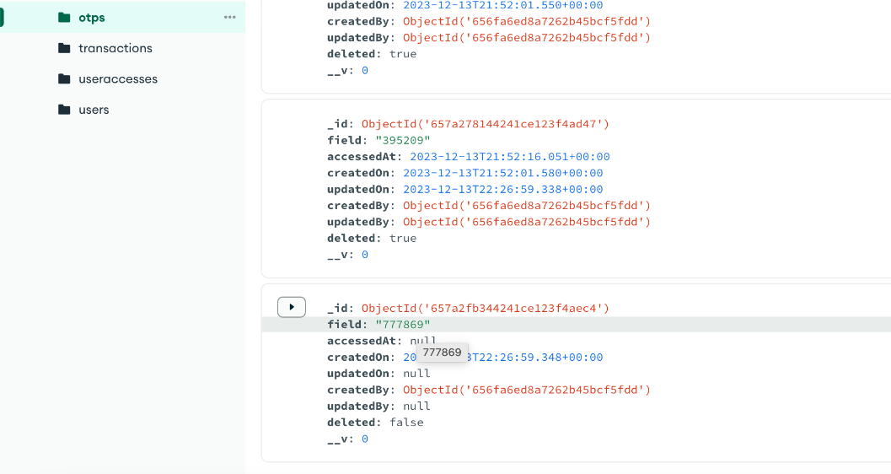
Sign in using otp
Embark on a secure digital journey with our streamlined login and sign-up pages! Harnessing the power of JWT for authentication, your data is fortified against unauthorized access.
Our MongoDB-backed system ensures robust storage of user login data, guaranteeing a seamless and protected user experience. Effortlessly sign up for a world of secure interactions, while our login page offers swift access, prioritizing your security and convenience.

Slide 8
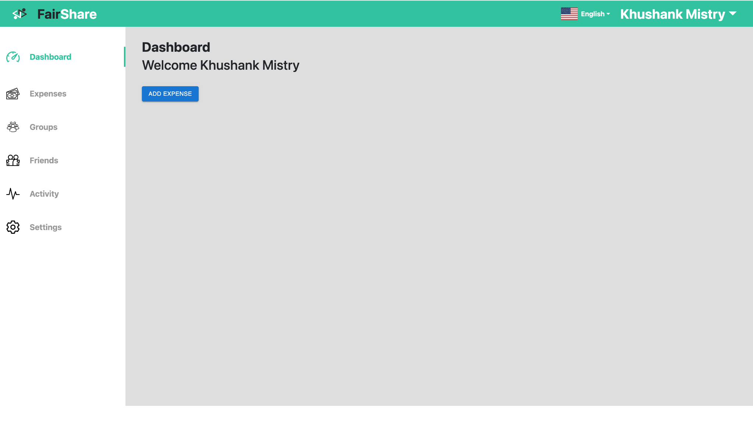
Dashboard
Our comprehensive dashboard lets you seamlessly navigate through different sections like Expenses, Groups, Friends, and Activity via an intuitive side panel.
The top-notch navigation bar offers language internationalization options, quick access to your profile picture, and a convenient drop down menu for easy logout.
Experience a user-friendly interface that effortlessly combines functionality and aesthetics for a personalized and enjoyable user experience.

Slide 9
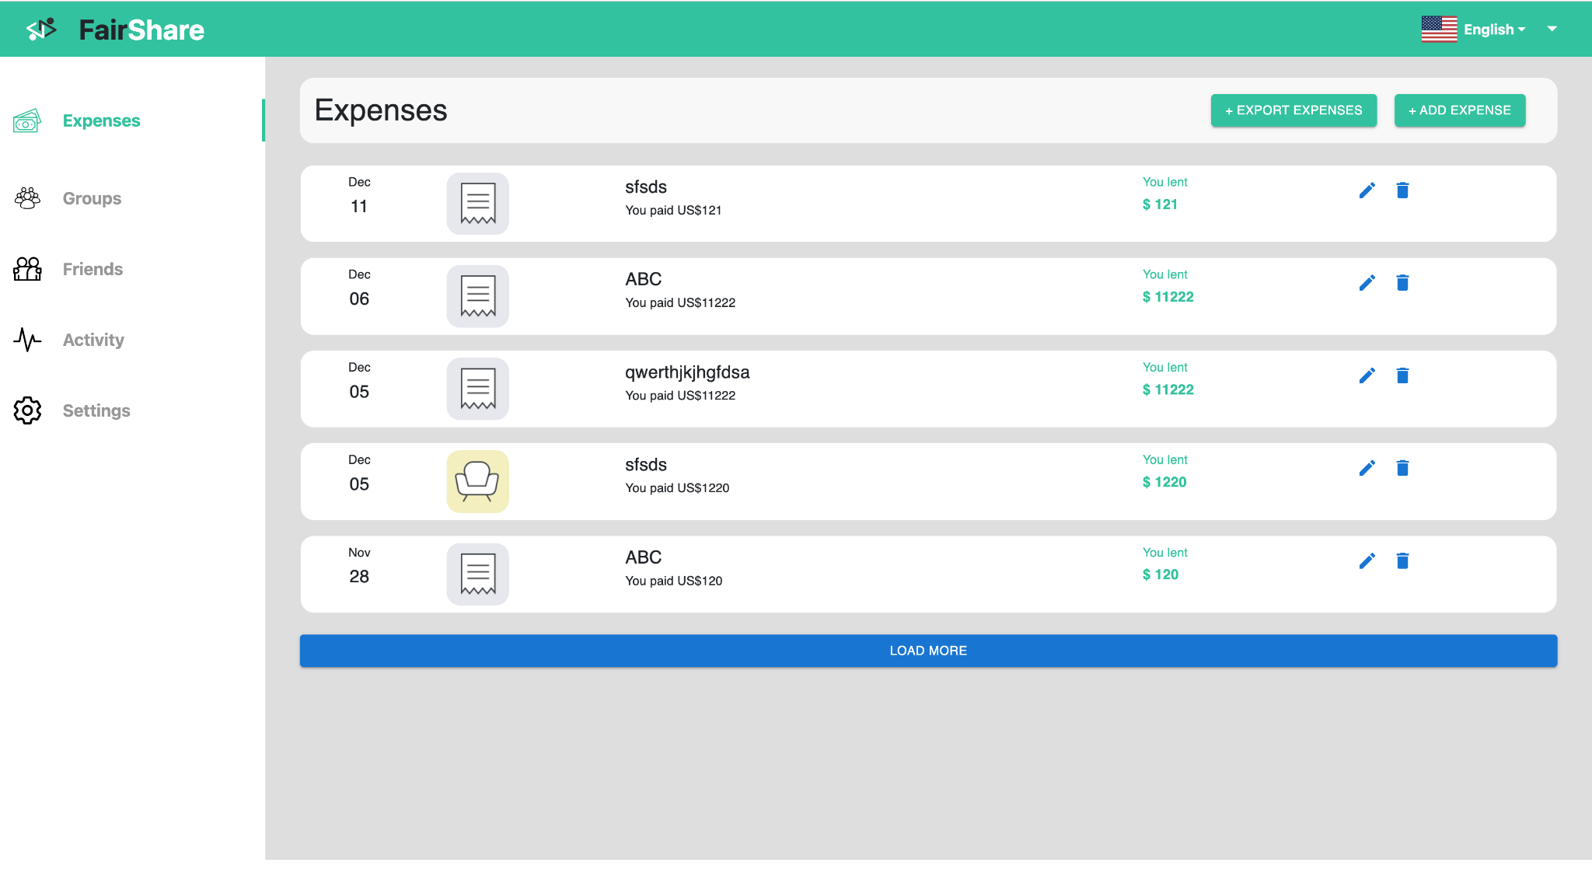
Expenses
Get a comprehensive overview of all your expenses neatly displayed. Adding a new expense is a breeze – simply enter the details and let our platform handle the rest. We can also export your expenses to a CSV file
Stay organized and in control of your spending with this user-friendly feature.

Slide 10
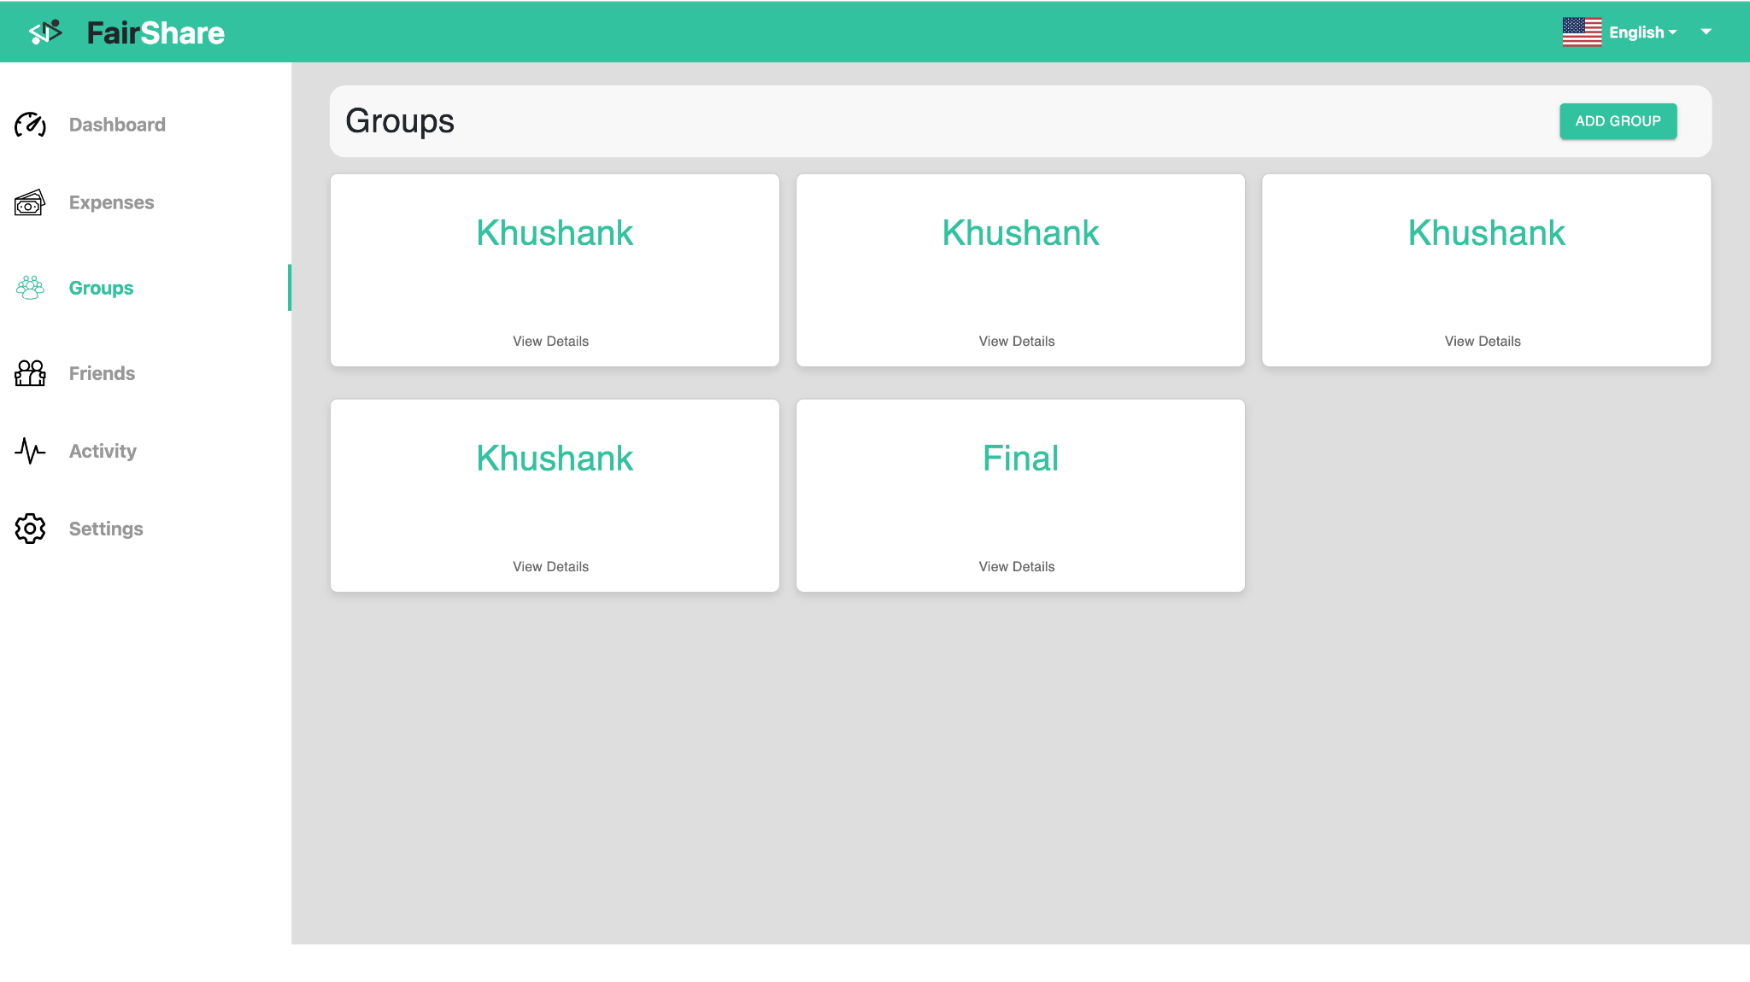
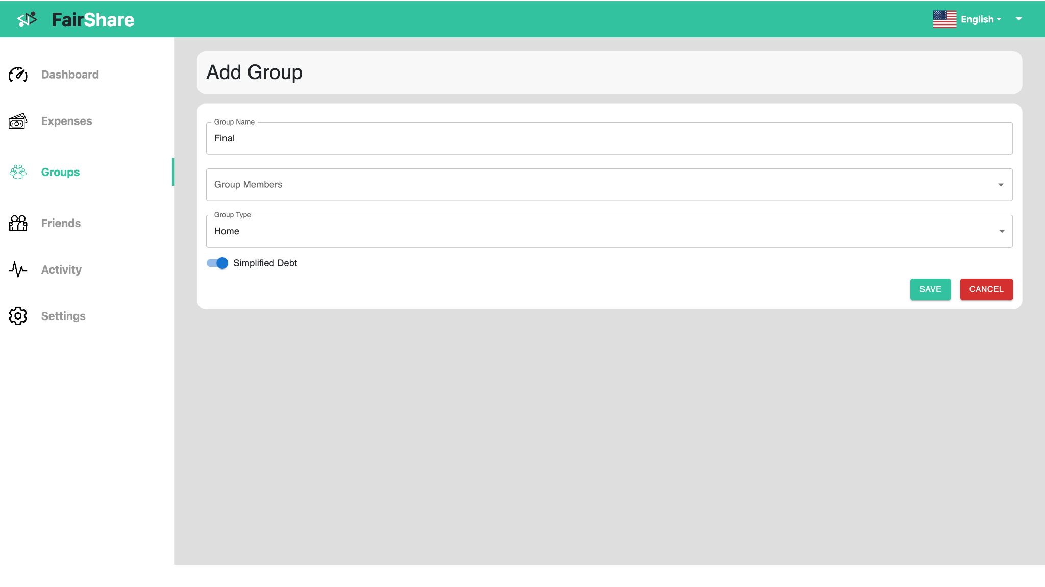
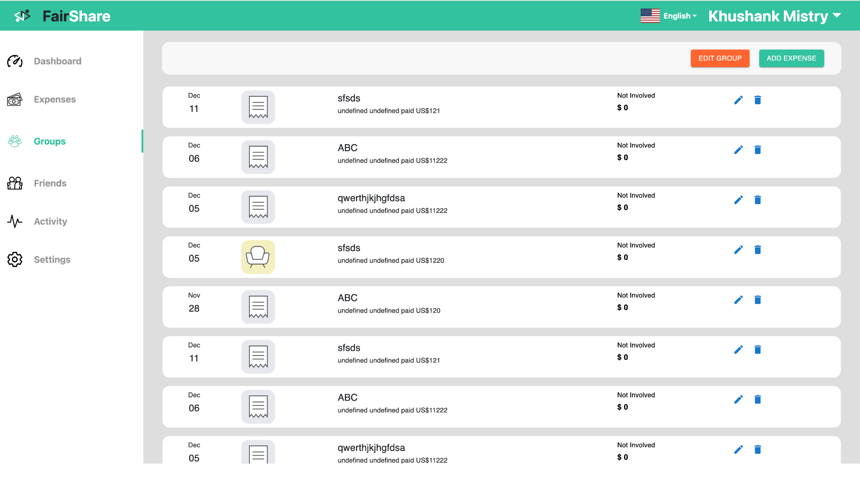
groups
Groups section on our dashboard. Seamlessly add and manage groups for shared expenses. Whether it's a trip with friends or joint household expenses, our platform makes group management a hassle-free experience.

Slide 11
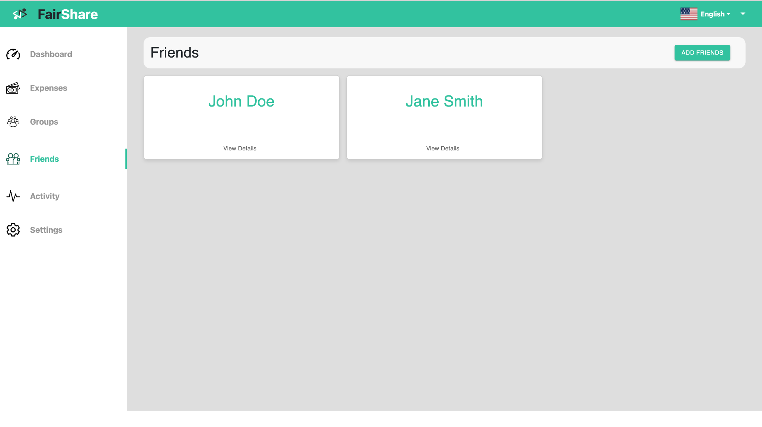
friends
Easily manage your social circles, add friends, and explore shared financial journeys. Keep tabs on money splits, ensuring financial harmony.
Strengthen your friendships with clear and transparent financial interactions.

Slide 12
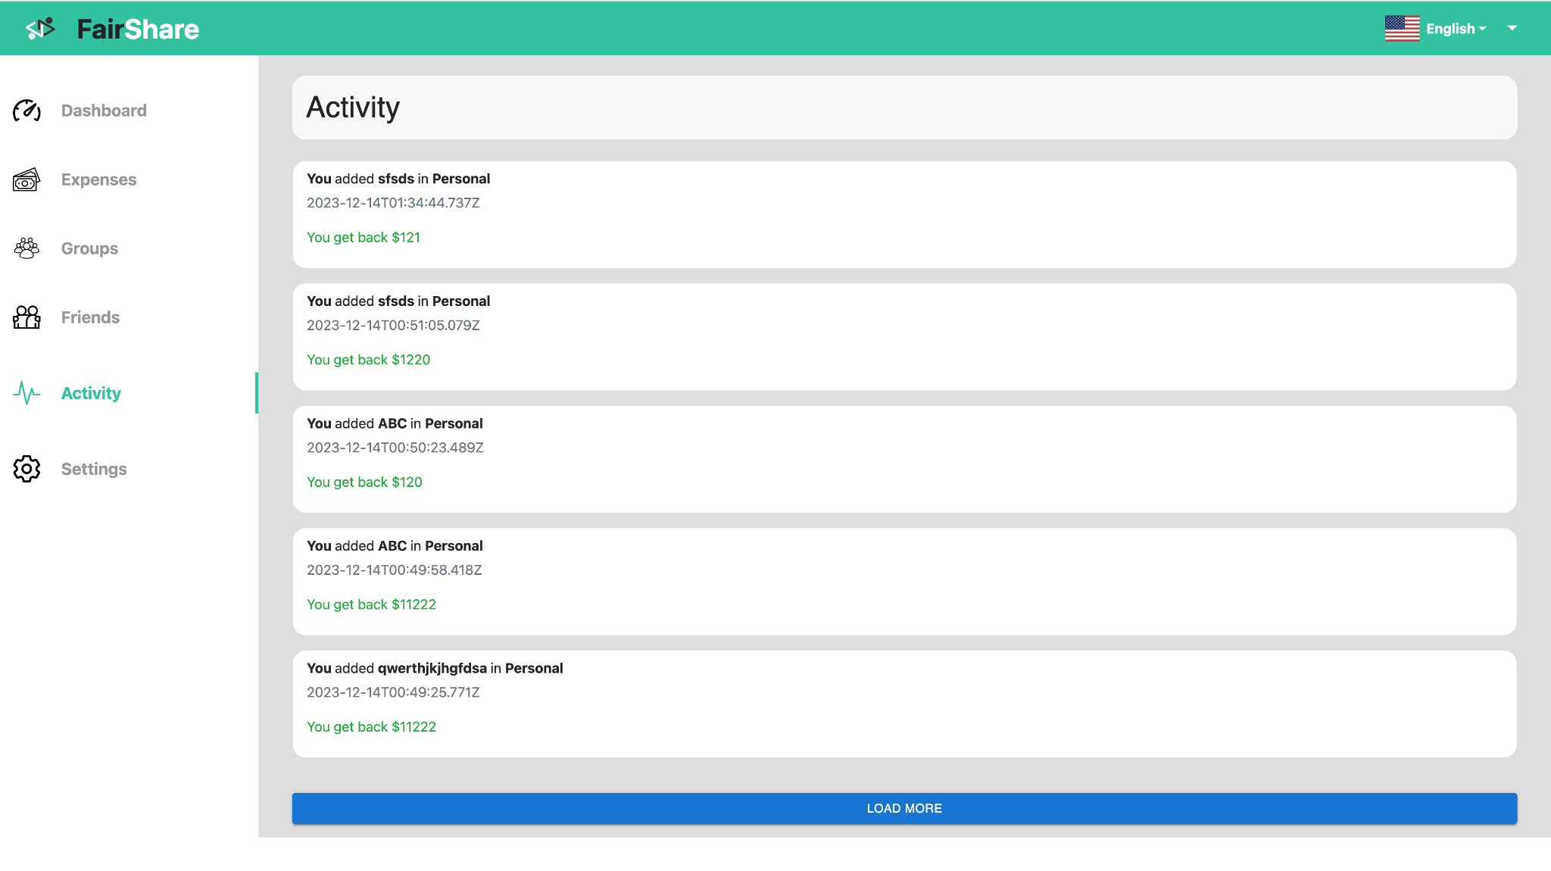
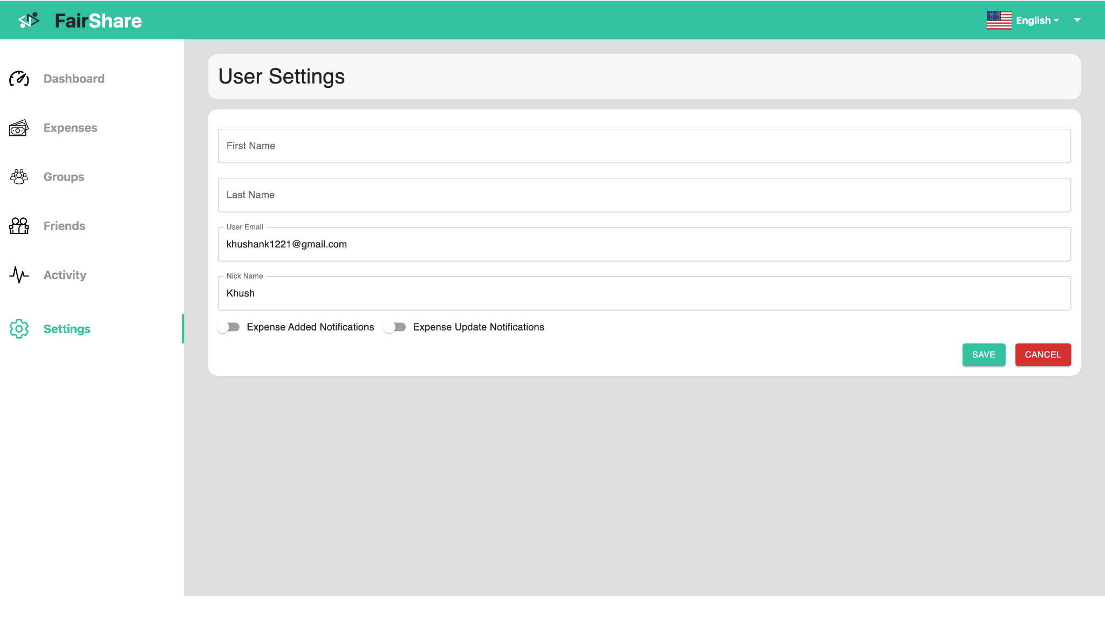
Activity and settings
The Activity section lets you stay informed about all financial splits and transactions in one place.
Customize your experience with the Settings section, where you can update your profile info and fine-tune notification preferences such as Expense Added Notifications, Expense Update Notifications.

Slide 13
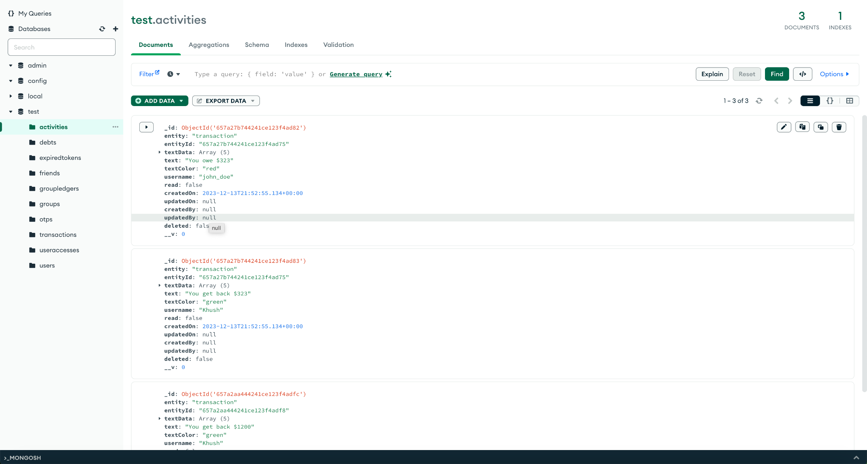
DataBase - MongoDB
Activities: Track every financial move and expense activity in real-time.
Debts: Effortlessly manage and monitor outstanding debts among friends and groups.
Expired Tokens: Securely handle and update authentication tokens for enhanced system security.
Friends: Easily add, manage, and view financial interactions with friends.
Group Ledgers: Gain insights into group finances with clear, comprehensive group ledgers.
Groups: Seamlessly create, join, and administer financial groups for shared expenses.
OTPs: Utilize one-time passwords for an added layer of security in transactions.
Transactions: Access a detailed log of all financial transactions, providing a transparent overview.
User Accesses: Manage user permissions and access to ensure a secure and controlled environment.
Users: Maintain profiles, preferences, and financial data for a personalized experience within our dynamic ecosystem

Slide 14
References
Professor Amuthan Arulraj:
Lectures of the professor and Videos on concepts (React Router, Redux, PWA, Internationalization)
Algorithmic Insight: Algorithm behind Splitwise's Debt Simplification Feature
MongoDB Development:
MongoDB Node.js Developer Path
MongoDB Learning Center
React.js Learning:
Scrimba - Learn React
Full Stack Open
API Design and Swagger UI:
Best Practices for API Design
How to Split Open API Spec into Multiple Files
Grouping Operations with Tags in Swagger
Video Resources:
YouTube: Splitwise Tutorial
YouTube: API Design Best Practices
React Exporting Data:
Export to CSV and JSON in React
How to Add Export to CSV Button in React Table
Low-Level Design Perspective:
Low-Level Design of Splitwise
React Development:
Official Documentation: React Documentation
React Router: React Router Documentation
State Management with Redux: Redux Documentation
JWT AUTH:
JWT.io Introduction: Introduction to JSON Web Tokens
Auth0 Blog: JWT Authentication: When and How to Use It
Material UI:
Material-UI Documentation: Material-UI Documentation
Material Design Guidelines: Material Design Guidelines
Design Inspiration:
Dribbble: Splitwise Expense Handling Web App
Node.js File Handling: How to Read Excel File in Node.js

Slide 15
MERN Stack Tutorials:
FreeCodeCamp MERN Stack Course: Learn the MERN Stack - Full Tutorial for Beginners
Traversy Media MERN Stack Series: MERN Stack Front To Back
MongoDB:
MongoDB University: MongoDB University Courses
MongoDB Atlas (Cloud Database): MongoDB Atlas Documentation
Advance React Patterns:
React Hooks: Understanding React Hooks by example
Higher Order Components (HOCs): A Comprehensive Guide to Higher-Order Components
Security in MERN stack:
OWASP for Web Security: OWASP Web Security Testing Guide
Secure Your React App: React Security Best Practices

